Slide 1
Object Orientation
Dr. Charles R. Severance
www.cc4e.com

Slide 2

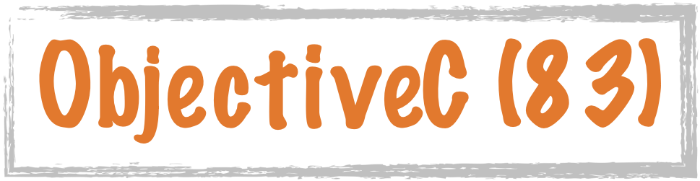








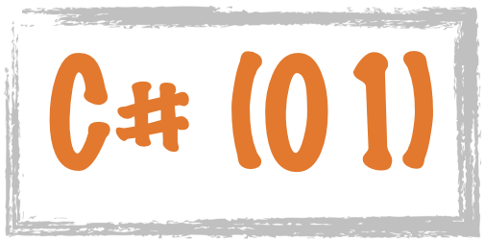


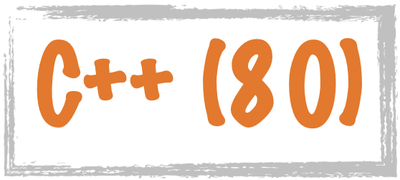









Science Calculations
System
System
C uses curly braces { } for code blocks.
Scripting/
Interpreted
http://en.wikipedia.org/wiki/History_of_programming_languages

Slide 3









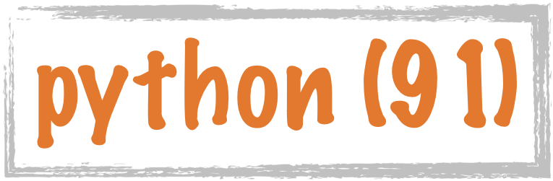

















Procedural
Hybrid
Object Oriented
Classes were added to PHP in 2000
https://en.wikipedia.org/wiki/Object-oriented_programming

Slide 4
Object Orientation Over Time
Python (1991)
C++ (1980)
Java (1995)
JavaScript (1995)
PHP (2000)
C# (2001)

Slide 5
import math
class PointClass:
def __init__(self, x, y):
self.x = x
self.y = y
def dump(self):
print('Object point@%x x=%f y=%f' %
(id(self),self.x,self.y))
def origin(self):
return math.sqrt(self.x*self.x+self.y*self.y)
pt = PointClass(4.0, 5.0)
PointClass.dump(pt)
print('Origin',pt.origin())
del(pt)
Object point@102ad1f10 x=4.000000 y=5.000000
Origin 6.4031242374328485
Python uses the concept of "self" to refer to the variables stored in the current instance. The constructor is by convention "__init__".
1992
kr_03_01.py

Slide 6
#include <iostream>
#include <math.h>
class Point {
public:
double x, y;
Point(double xc, double yc) {
x = xc;
y = yc;
};
void dump() {
printf("Object point x=%f y=%f\n", x, y);
}
double origin() {
return sqrt(x*x+y*y);
}
};
int main() {
Point pt(4.0, 5.0);
pt.dump();
printf("Origin: %f\n", pt.origin());
}
Object point x=4.000000 y=5.000000
Origin: 6.40312
C++ was initially implemented as a pre-processing pass that did textual transformations and then passed the code into the C compiler. There is no concept of "self" or "this".
1980
kr_03_01.cpp

Slide 7
import java.lang.Math;
public class Point {
double x,y;
Point(double x, double y) {
this.x = x;
this.y = y;
}
void dump() {
System.out.printf("%s x=%f y=%f\n",
this, this.x, this.y);
}
double origin() {
return Math.sqrt(this.x*this.x+this.y*this.y);
}
}
------------------------------------------------------
public class cc_03_01 {
public static void main(String[] args)
{
Point pt = new Point(4.0, 5.0);
pt.dump();
System.out.printf("Origin %f\n",pt.origin());
}
}
Point@7cef4e59 x=4.000000 y=5.000000
Origin 6.403124
The keyword "this" is a reserved word in the Java language. It is used to refer to the current instance of the class. The constructor is an un-typed function with the same name as the class. When you print "this" out, it resolves to the name of the class and an indication of which instance we are currently in. The toString() method produces the string.
Point.java
kr_03_01.java
1995

Slide 8
function Point(x, y) {
this.x = x;
this.y = y;
this.party = function () {
this.x = this.x + 1;
console.log("So far "+this.x);
}
this.dump = function () {
console.log("Object point x=%f y=%f",
this.x, this.y);
}
this.origin = function () {
return Math.sqrt(this.x*this.x+this.y*this.y);
}
}
pt = new Point(4.0, 5.0);
pt.dump();
console.log("Origin %f",pt.origin());
Object point x=4 y=5
Origin 6.4031242374328485
JavaScript takes the "this" and "new" keywords from Java but not much else. There is no "class" keyword. Formatted The way methods are defined take inspiration from functional languages like Scheme and use the "first-class function" pattern. Output tracks C very closely. The class definition itself overloads the "function" keyword.
TypeScript is an "evolved" version of JavaScript and adds "class" and "this" keywords allowing for a more traditional Java-like syntax for declaring objects.
1995
kr_03_01.js

Slide 9
class Point {
private $x, $y;
public function __construct($x, $y) {
$this->x = $x;
$this->y = $y;
}
public function dump() {
printf("Object point x=%f y=%f\n",
$this->x, $this->y);
}
public function origin() {
return sqrt($this->x*$this->x+
$this->y*$this->y);
}
}
$pt = new Point(4.0, 5.0);
$pt->dump();
printf("Origin %f\n",$pt->origin());
Object point x=4.000000 y=5.000000
Origin 6.403124
PHP introduced Object Orientation in PHP 4 in 2000 so it could borrow patterns like "this", "class", and "new" from languages like Java. Because PHP started with Perl 😞 , variables start with '$'. Also, PHP uses the '.' operator for concatenation for the "object lookup" operator, PHP had to use "->" which is inspired by the syntax C uses with a pointer to a structure.
2000
kr_03_01.php

Slide 10
using System;
public class Point
{
public double x,y;
public Point(double cx, double cy) {
x = cx;
y = cy;
}
public void dump() {
Console.WriteLine("Point object x={0} y={1}", x, y);
}
public double origin() {
return Math.Sqrt(x*x+y*y);
}
}
class TestPoint{
public static void Main(string[] args)
{
Point pt = new Point(4.0, 5.0);
pt.dump();
Console.WriteLine("Origin {0}", pt.origin());
}
}
Point object x=4 y=5
Origin 6.40312423743285
Microsoft's C# was relatively recent and so it could look at the other approaches and pick what they saw as the best parts. C# took most of its inspiration from Java.
2001
kr_03_01.cs

